Slide 1
Data Visualization

Slide 2
What is data visualization?
= the presentation of data, information, knowledge, or insight in a pictorial or graphical format

Slide 3
DH Seminar Composition by Department, 2014-2015 (pie chart)

Slide 4
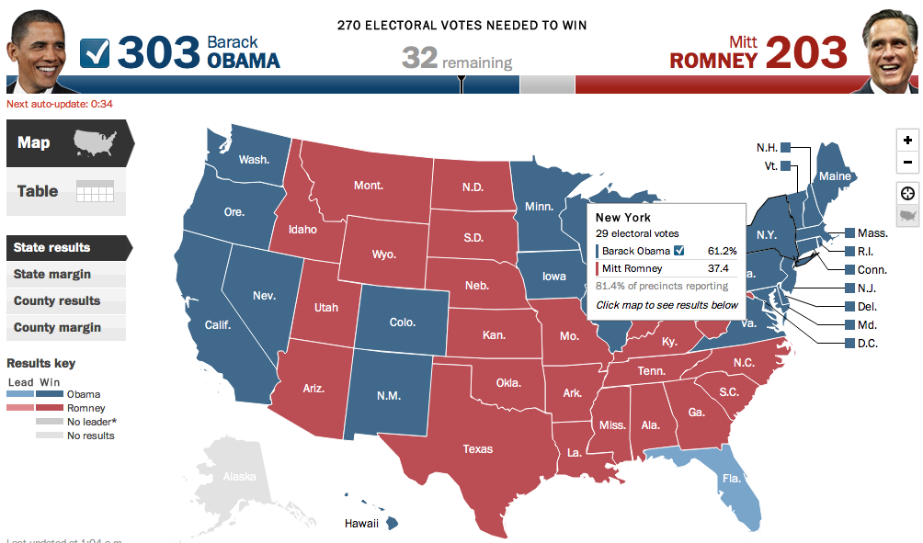
2012 U.S. Presidential Election Results, NPR (map)

Slide 5
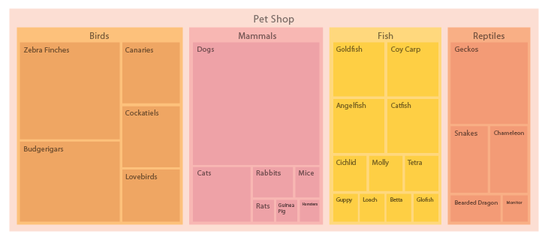
Treemap
Visualize hierarchies – and the quantity of each sub-category within a greater category (the love child of pie and org charts)
Picture: http://www.datavizcatalogue.com/methods/treemap.html

Slide 6
Bubble Graph
A graph in which bubbles represent categories, comparing these categories both through bubble sizes and through bubble positions.
http://www.informationisbeautiful.net/visualizations/snake-oil-superfoods/

Slide 7
Fun with Dataviz

Slide 8
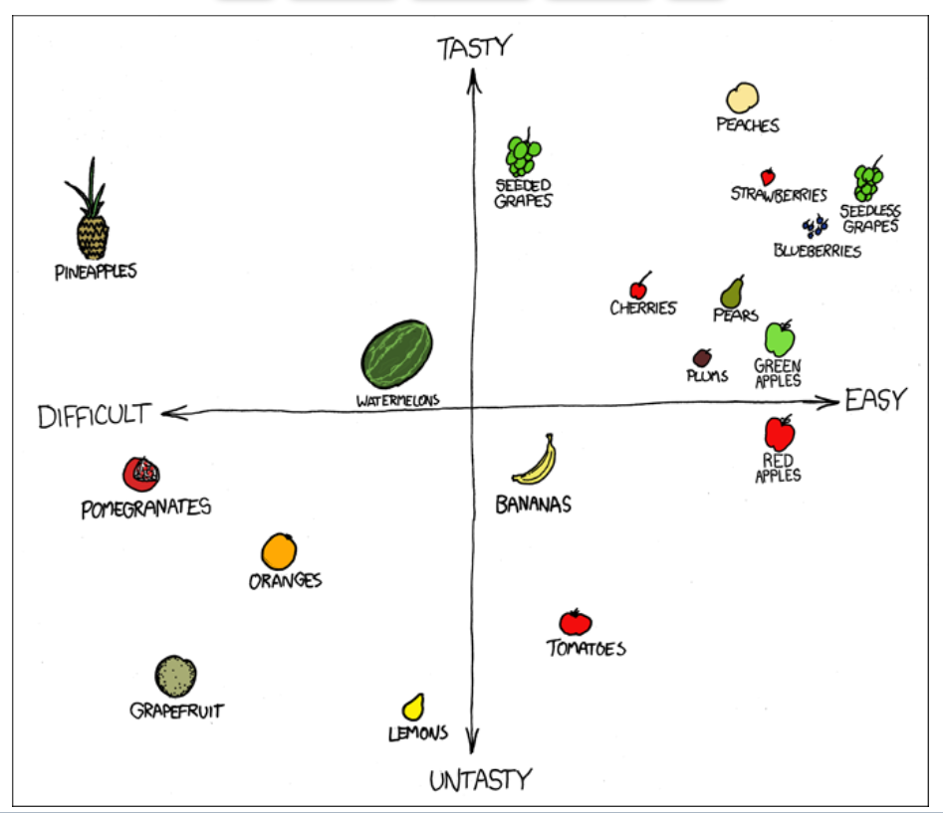
XKCD, “F^&% Grapefruit,” x-y chart

Slide 9
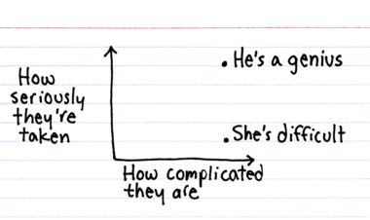
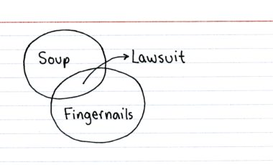
Jessica Hagy, ThisIsIndexed.com

Slide 10
Lying with Dataviz

Slide 11
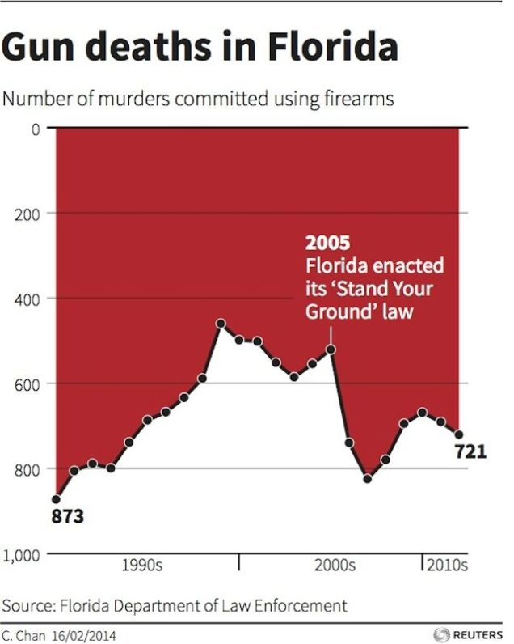
How to Lie with Data Visualization

Slide 12
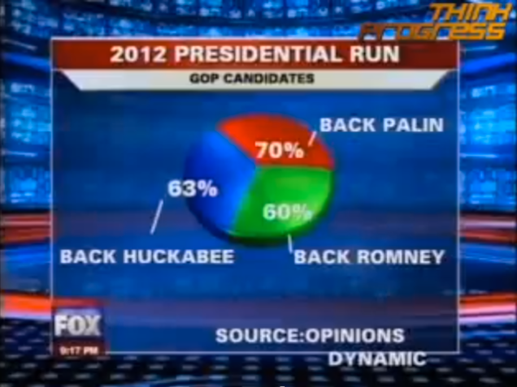
How to Lie with Data Visualization

Slide 13
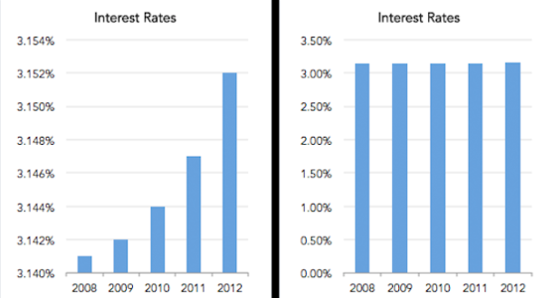
How to Lie with Data Visualization

Slide 14
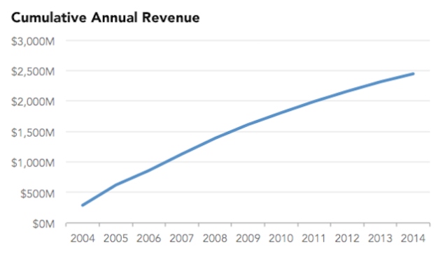
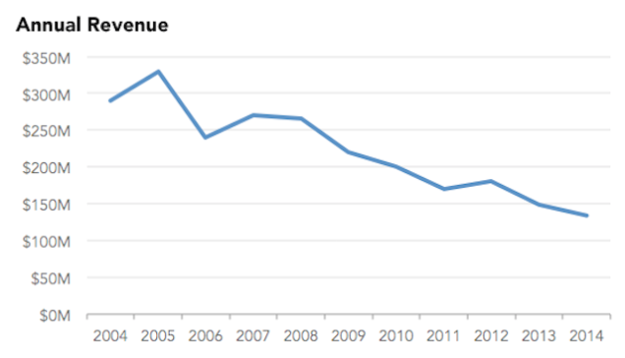
How to Lie with Data Visualizations
Cumulative revenue: running total of revenue earned to date (i.e. 2006 = 2006 + 2005 + 2004)
Annual revenue:
total revenue earned in current year (i.e. 2006 = 2006)
How to Lie with Data Visualization

Slide 15
Graphesis
Johanna Drucker: graphesis = “the field of knowledge production embodied in visual expressions … a visual epistemology” (Drucker, “Graphesis” 2011)
Visual forms carry the assumptions and values of their fields of origin, and impose these assumptions and values on the data they present, whether these assumptions and values are appropriate to that data or not.
As humanists, we ask ourselves: What arguments, values, and perspectives do visualizations encode and embody? What kind of knowledge do they produce? What field’s assumptions do they draw from?

Slide 16
Data vs. Capta
Data: “given”, objective, observed
Quantitative approaches: from concordances to corpora, from measuring word frequencies and stylometric patterns to thematic discovery through topic modelling
Visual representations of quantities, trajectories, measurable relationships
Wordle, Gephi, Cytoscape; pie charts, bar charts, and bubble graphs
Capta: “captured”, constructed, interpreted, subjective
Qualitative approaches: visual and performative, enacting poetics, making subjectivity and interpretation visible
Maps and timelines of literary narratives; digital collections; interpretive visualizations
Neatline, Neatline Time, Omeka

Slide 17
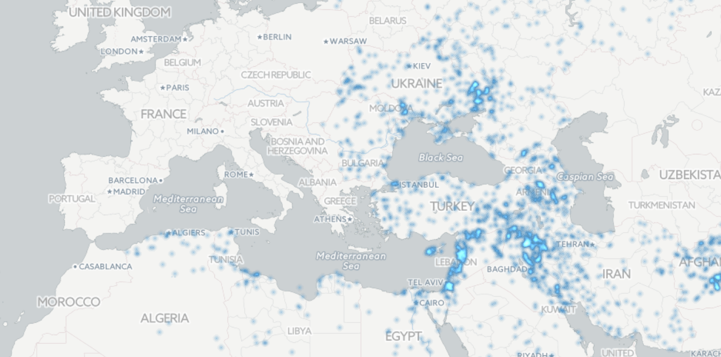
Data vs. Capta: Two Maps
GEOPOLITICAL TENSIONS IN MENA (Middle East & Northern Africa)

Slide 18
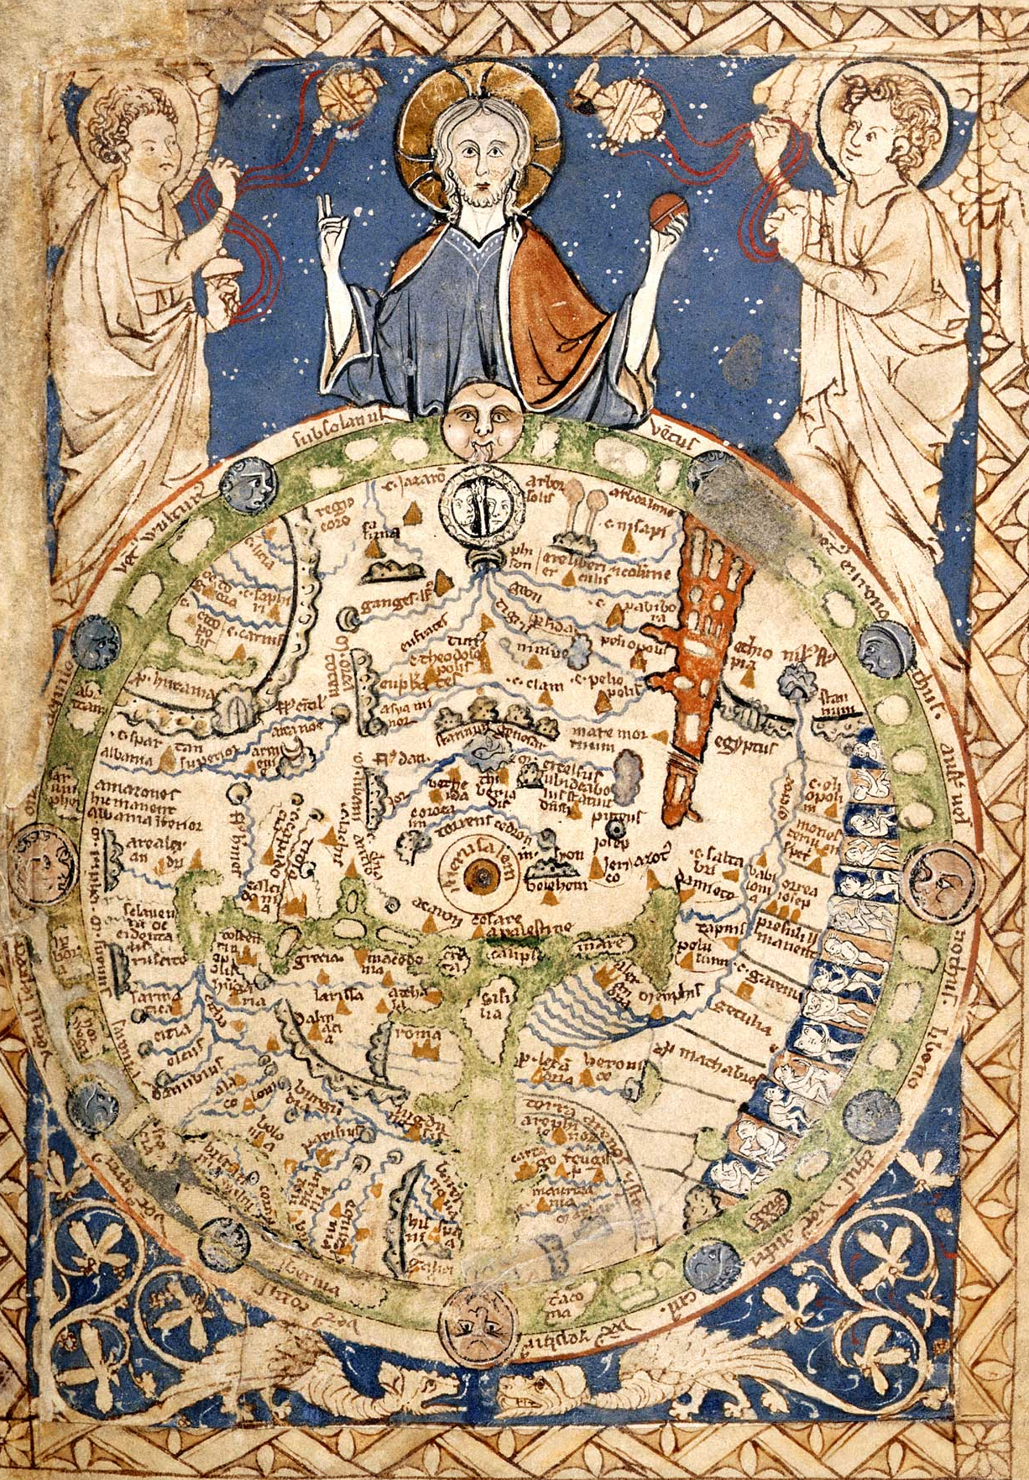
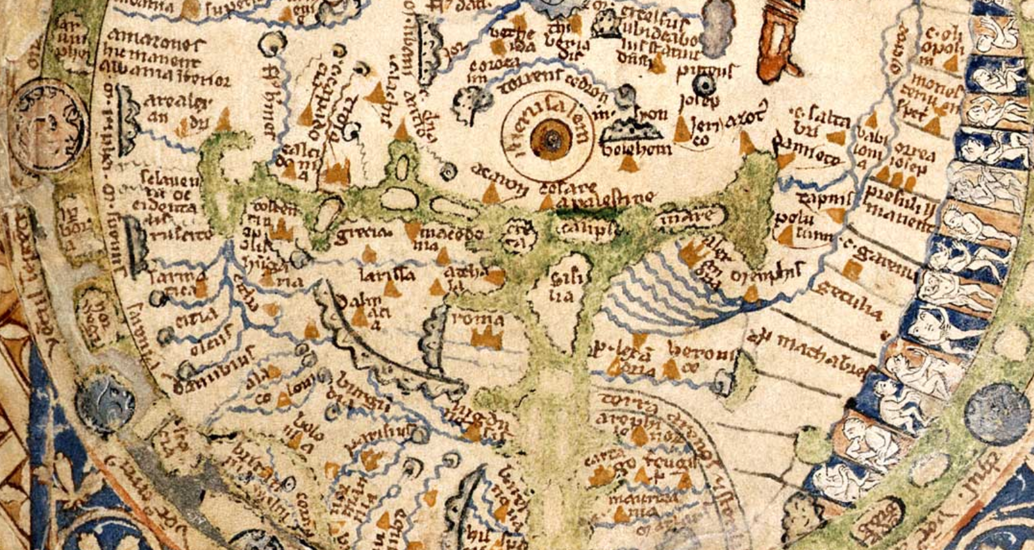
Data vs. Capta: Two Maps
BRITISH LIBRARY, The PARIS PSALTER map (c. 1300, England)

Slide 19
DH-ing with Dataviz

Slide 20
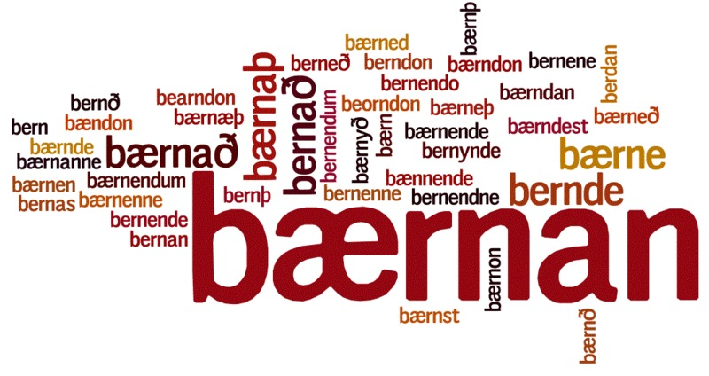
Word Cloud
Visualizes word frequencies in a text
The larger the word, the more often it appears

Slide 21
Network Graph
Network Graph:
Things: nodes (vertices)
Relationships: edges
Network

Slide 22
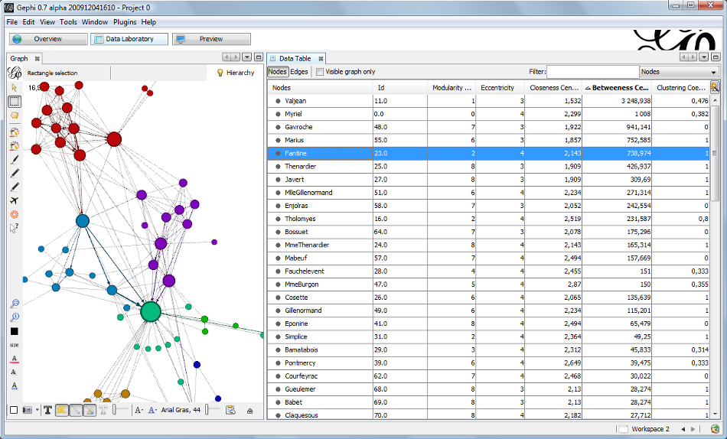
Les Miserables: Network Graph of Character Interactions
Network graph from Gephi (http://gephi.github.io/images/screenshots/datatable.png). See also Gephi Datasets (https://wiki.gephi.org/index.php/Datasets): “Coappearance weighted network of characters in the novel Les Miserables.” D. E. Knuth, The Stanford GraphBase: A Platform for Combinatorial Computing, Addison-Wesley, Reading, MA (1993).

Slide 23
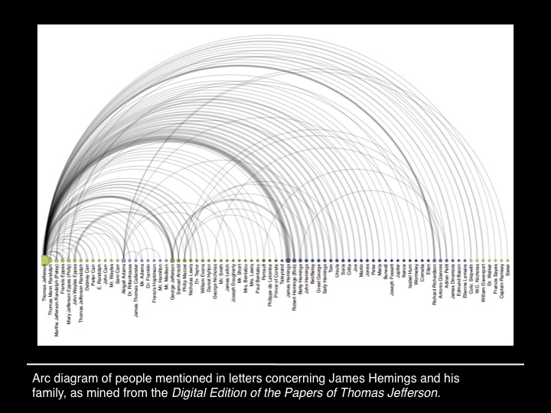
Lauren F. Klein, “A Report Has Come Here”
“This figure is James Hemings, Thomas Jefferson’s enslaved personal chef (and Sally Hemings’s older brother). When Jefferson was appointed Ambassador to France, he took Hemings with him to Paris, and there apprenticed him to the chef of a prince. Through the few archival records that relate to Hemings, we also know, for instance, that while in Paris, Hemings hired his own tutor and learned to speak fluent French. And here’s another thing Hemings learned in Paris: what it might mean to be free. […]
It is then a striking instantiation of archival silence that when you perform a “Name” search for a person named James Hemings in the The Papers of Thomas Jefferson, Digital Edition, you get no results—because Hemings, in spite of his ability to read and write in two languages–because of his status as a slave–was not a person to whom Jefferson ever wrote, or from whom Jefferson received letters.”

Slide 24
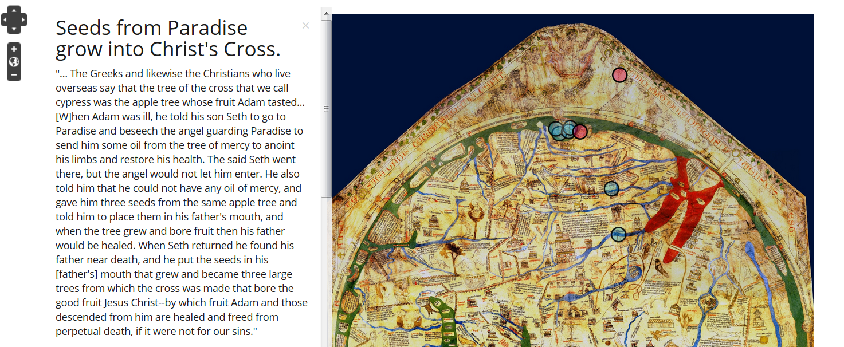
Project Paradise: A. Bolintineanu Conversation: Hereford Map & Book of John Mandeville

Slide 25
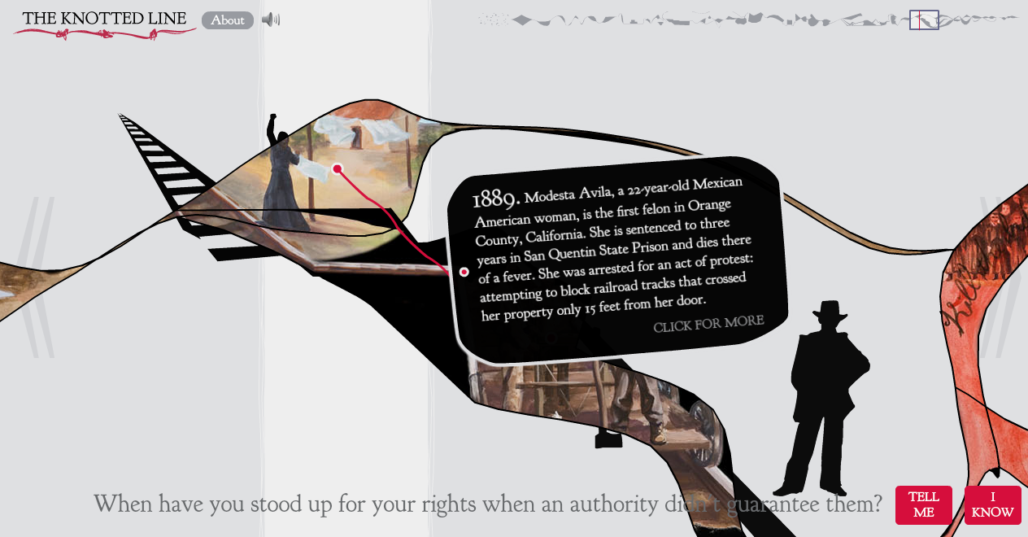
The Knotted Line
“an interactive, tactile laboratory for exploring the historical relationship between freedom and confinement in the geographic area of the United States” (http://knottedline.com/)

Slide 26
Further Reading
Johanna Drucker, Graphesis
David McCandless, http://www.informationisbeautiful.net/
Bethany Nowviskie, http://nowviskie.org/2014/neatline-and-visualization-as-interpretation/
Severino Ribecca, http://www.datavizcatalogue.com/index.html

